Slide 1

MyAccessID in Practice: From Concept to Integration in Cambridge’s AIRR Platform
National Federated
Compute Services
NetworkPlus
MyAccessID Online Workshop – 2nd December 2025
Deepak Aggarwal, Research Computing Services

Slide 2

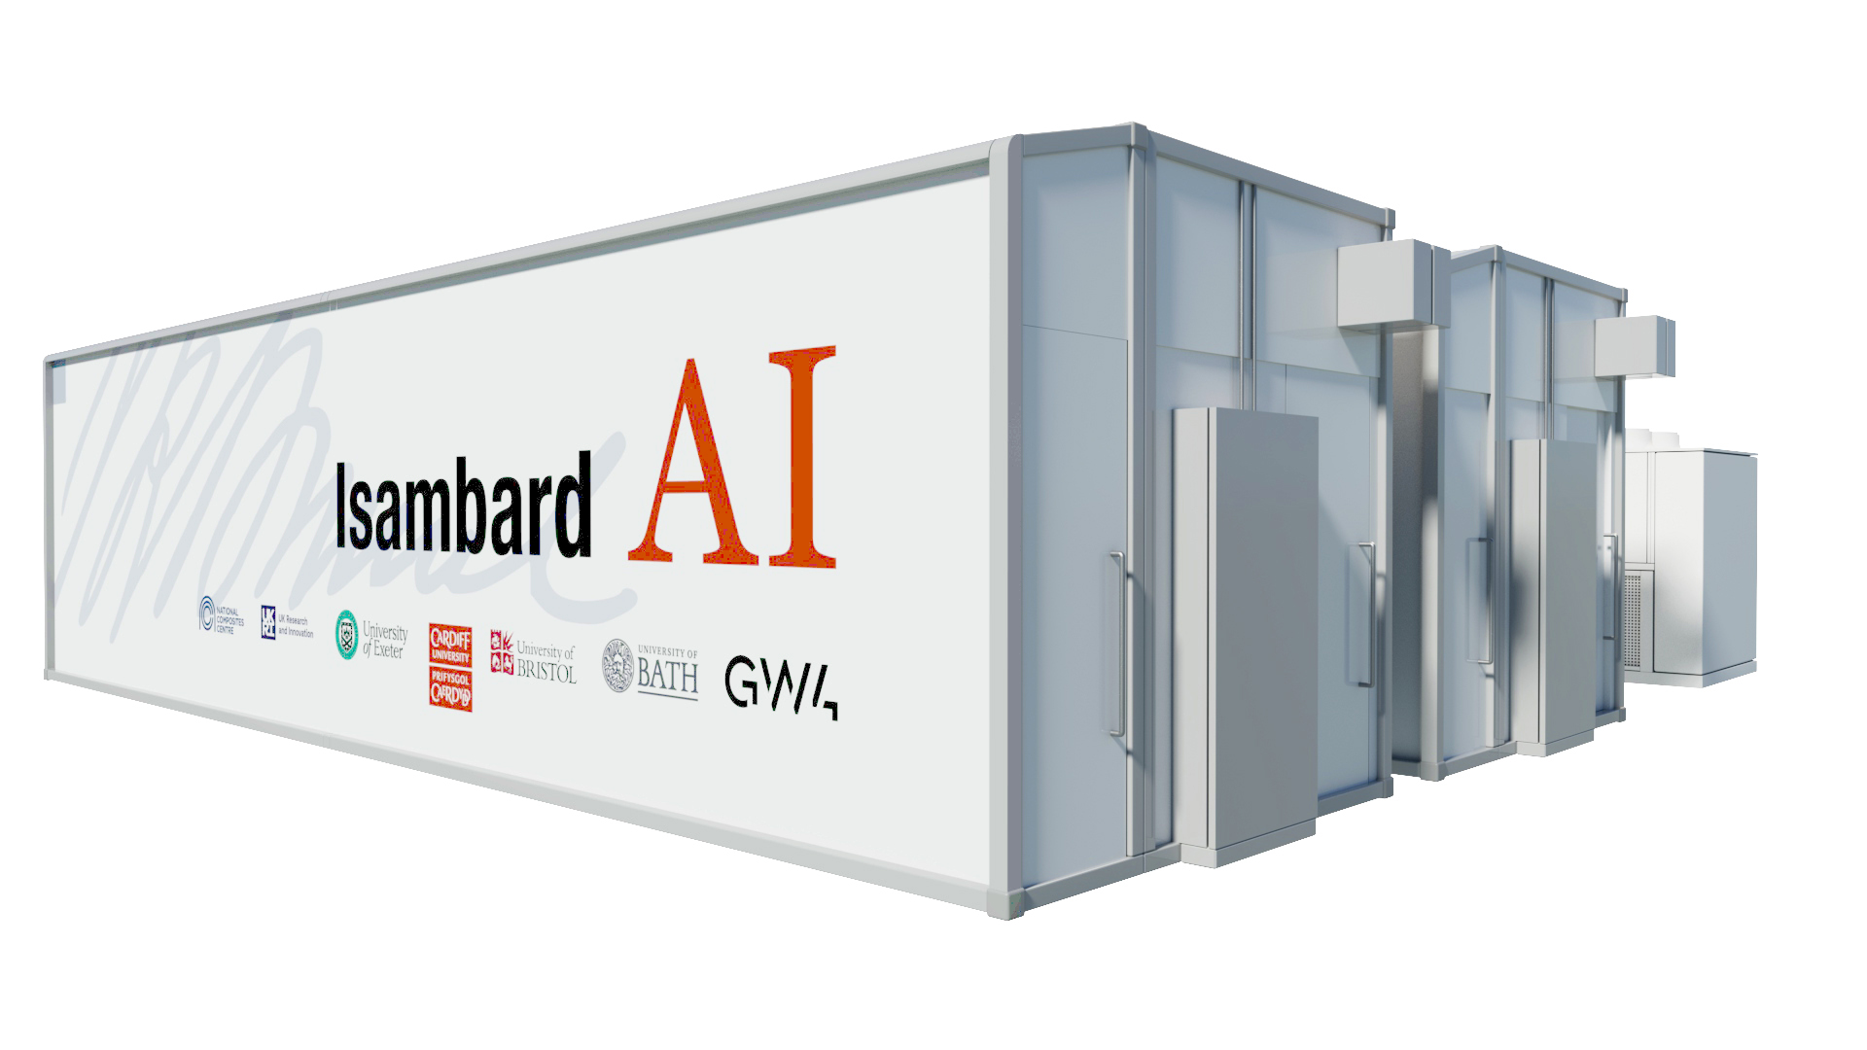
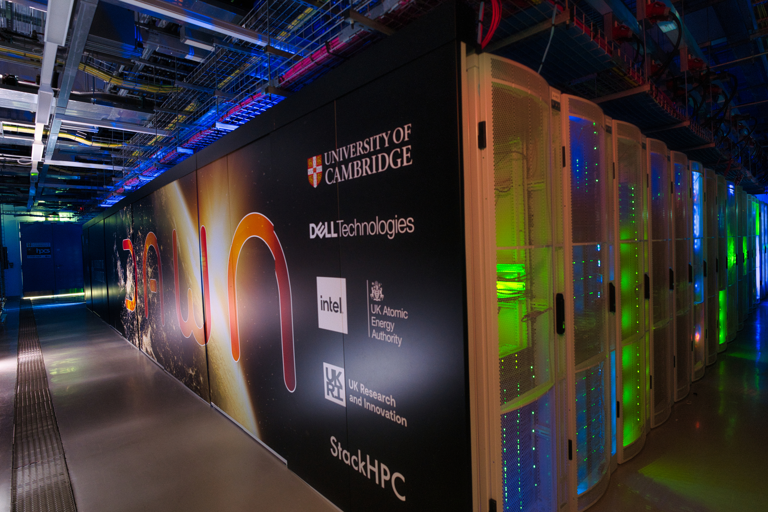

AIRR
UKRI as Allocator
=
In January 2025, the government announced expanding AIRR capacity, by at least 20x by 2030, as part of the AI Opportunities Action Plan.
Goal: A researcher should be able to access Dawn and Isambard-AI using their existing institutional credentials, without needing to create or manage separate accounts for each site.

Slide 3
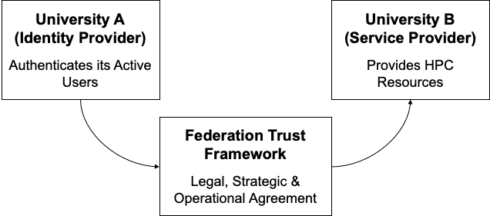
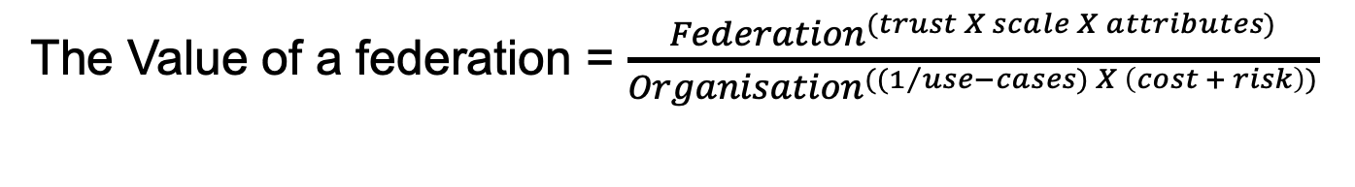
FEDERATION?
The Value of a federation = $\frac{{Federation}^{(trust X scale X attributes)}}{{Organisation}^{((1/{use−cases) }X \left(cost + risk\right))}}$
Slide content courtesy of Josh Howlett presentation at AAAI workshop in Reading

Slide 4
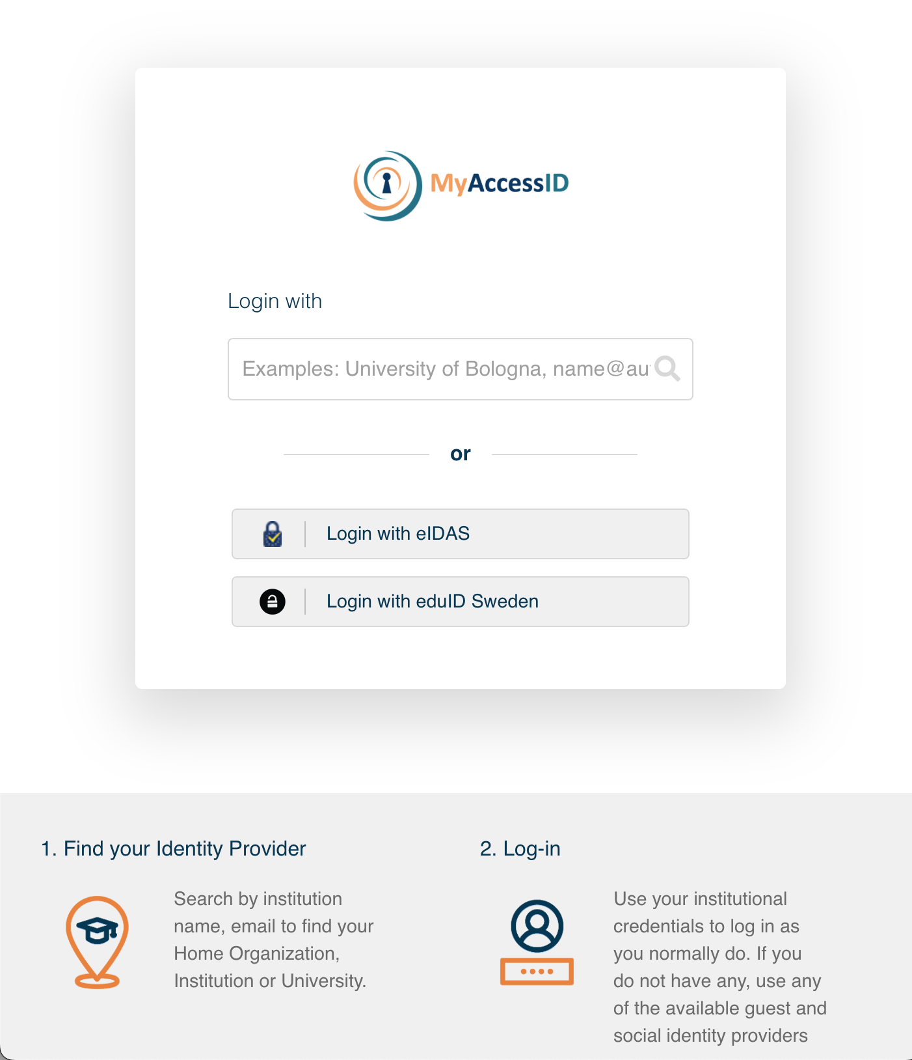
MyAccessID – Federated Identity
Identity and Access Management Service provided by GEANT for the purpose of offering a common Identity Layer for Infrastructure providers
Connects to eduGAIN Identity Providers, i.e. users can log in using their normal academic credentials
International – works across the UK, EU, US, Asia
Authenticates a researcher’s university email address
MyAccessID: https://wiki.geant.org/display/MyAccessID

Slide 5
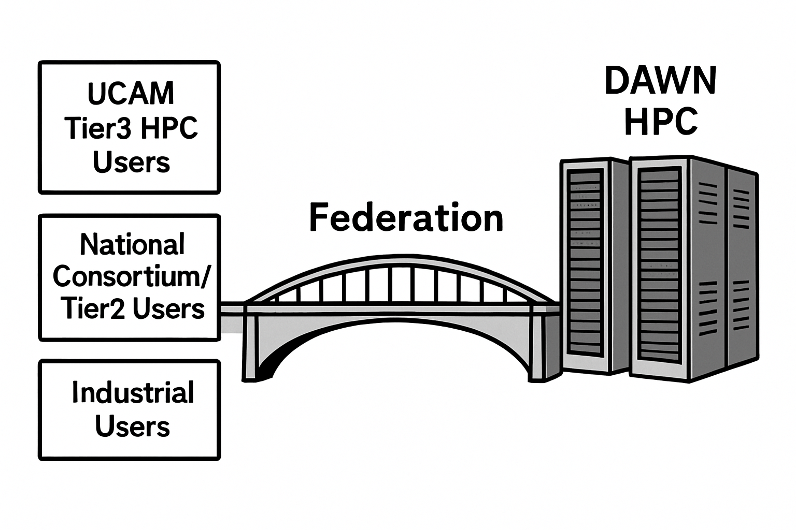
The Case for Federation in Research Computing
Researchers collaborate across institutions and need access to multiple DRIs
At Cambridge, user-specific onboarding
UCAM Tier3 HPC Users
via University AD
National Consortium/Tier2 Users
via project specific SAFE portal
Industrial Users
Email address and ssh key
Expectation: Streamlined onboarding

Slide 6
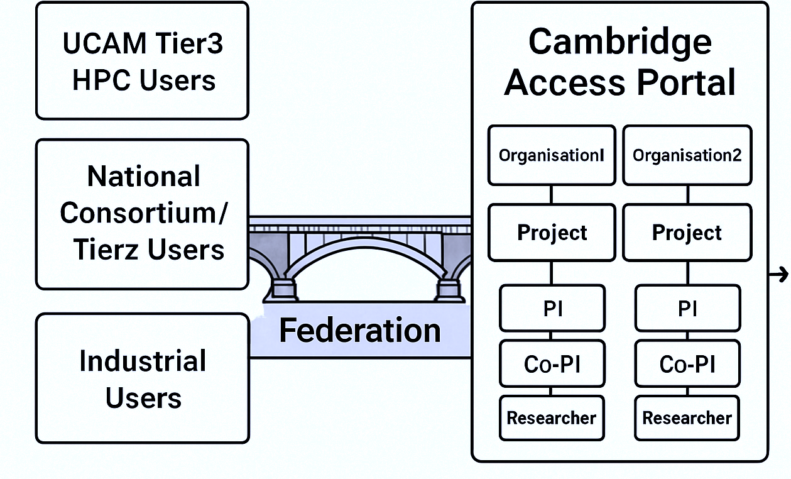
Federation at Cambridge with AIRR Dawn (Access) Portal

Slide 7





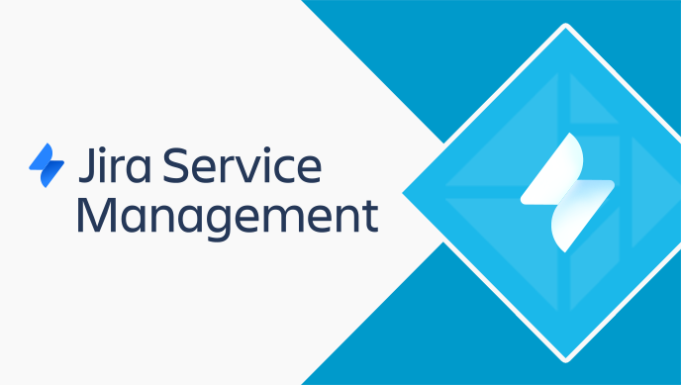





AIRR Dawn Portal: Solution Components
Federated Identity
Integrated MyAccessID with Keycloak for secure, federated authentication.
Using two separate realms in Keycloak, one for Waldur users and other for our LDAP users.
Enabled non-MyAccessID users with local Keycloak account (Identity of Last Resort).
Project Management
Waldur as a centralized platform for all service offerings and project management portal connected with Jira Service Desk
Access to Compute Resources and Workflows
LDAP users can use MyAccessID to log into Open OnDemand.
TREs through K8s
MyAccessID: https://wiki.geant.org/display/MyAccessID
Waldur: https://waldur.com/
Azimuth: https://www.stackhpc.com/azimuth-introduction.html

Slide 8
Keycloak Integration – Dual Use Cases
Two Modes of MyAccessID Integration
Use Case | Realm | User Source | Behaviour
Open access to AIRR Dawn Portal | AIRR | MyAccessID only Identity of last resort for non-MyAccessID users | MyAccessID user can log in and accept the invitation For non-MyAccessID users, local Keycloak account is created.
Controlled access to OnDemand | CSD3 | MyAccessID + LDAP | Only users existing in LDAP can log in via MyAccessID
Enabled TOTP flow for enhanced login security

Slide 9
How MyAccessID Work for AIRR Dawn Portal?
MyAccessID looks up your university's Identity Provider (IdP) via eduGAIN
MyAccessID redirects to your University login page
You provide your University credentials
You select MyAccessID on the login page
Once authenticated, MyAccessID sends limited user info (name, email, affiliation) to site portal using OIDC
You visit the AIRR Dawn Portal
You are now successfully logged into site portal

Slide 10
Common User Issues (1/2)
Access to AIRR Dawn Portal depends on the email address matching between:
The project invitation
The mail attribute released by the user’s institution via MyAccessID
Mismatches occur when:
The user logs in with abc1234@university.ac.uk
But their IdP releases firstname.lastname@college.university.ac.uk
Result: User can't access their invitation or is treated as a new/unlinked user
Solution: Ask the PI/User check MyAccessID attribute checker tool

Slide 11
Common User Issues (2/2)
MyAccessID Usernames Can Change When an IdP Updates Its Configuration:
MyAccessID builds usernames from identity attributes released by the user’s home IdP
When an IdP changes its configuration, the identifiers it sends can also change
MyAccessID treats these new identifiers as a new user identity
This can cause the visible username in MyAccessID/AIRR to change unexpectedly

Slide 12
Lessons from MyAccessID Integration
Initial registration of the service took around 20 days
MyAccessID requires explicit, fully-qualified redirect URLs
Wildcards are not supported e.g. https://example.org/* → invalid
Each redirect URL must be listed exactly
Integration was straightforward but Mapping and sync mode settings are critical
MyAccessID support team is quite responsive
We have had 2 noticeable incidents of where MyAccessID was down
Users were not able to login to the Dawn portal and OpenOnDemand portal but could submit the jobs on the system with SSH access
but they were short and well-communicated.

Slide 13
Acknowledgements
MyAccessID team for ensuring the registration of service and resolving our queries timely.
Bristol Team for helping us in setting-up the connection.

Slide 14

Thank You
Questions?
https://www.hpc.cam.ac.uk/

